Slide 1
Overview Dashboard
Summarize the number of respondents and their demographics.

Slide 2
Competitive Landscape Dashboard
Understand how major coffee brands compete in scale, growth, and customer perception across key attributes.

Slide 3
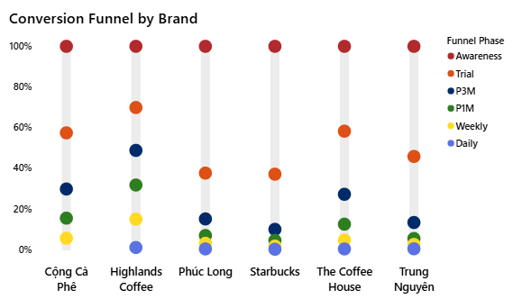
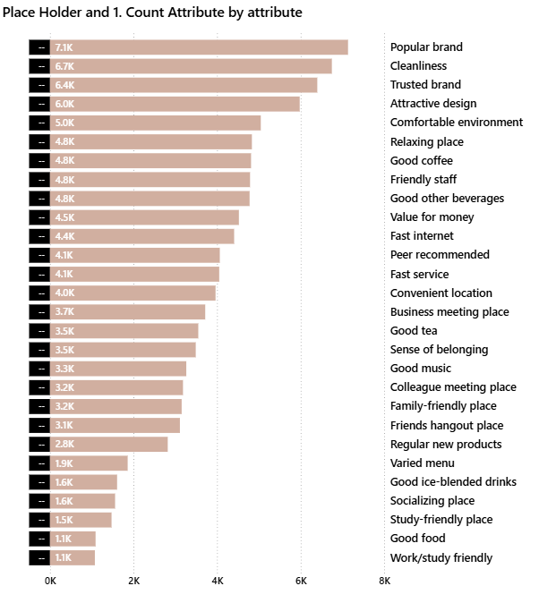
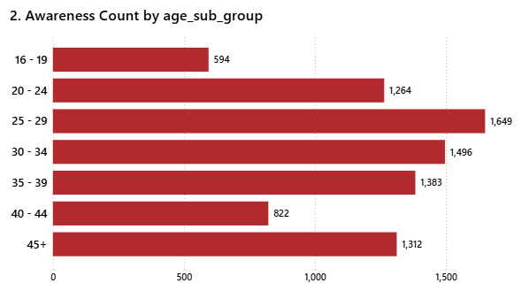
Conversion Analysis Dashboard
Uncover key leakage points and understand what drives or hinders customer retention.

Slide 4
Conversion Analysis Dashboard
Uncover key leakage points and understand what drives or hinders customer retention.

